Slide 1

SmartCrop Innovators
MD SHAHID ANSARI
Harnessing Data for Agricultural Growth

Slide 2
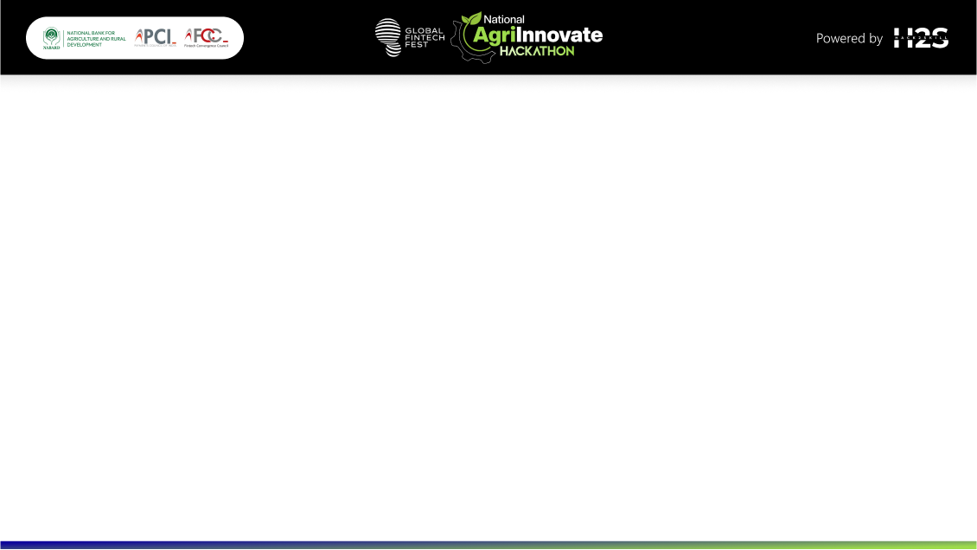
Solution Overview :
AI analyzes historical climate data, weather forecasts, and soil conditions to recommend crop selection, planting times, and resource allocation based on predicted weather patterns.
Helps farmers adapt to a changing climate by optimizing farming practices.

Slide 3
How is it different from existing ideas?
Integrates multiple data sources (climate data, soil conditions, weather forecasts) for real-time decision-making.
Tailored recommendations specific to local conditions and crop types.
How does it solve the problem?
Provides actionable insights that can directly impact crop yield and resource efficiency.
USP (Unique Selling Proposition):
AI-driven, real-time, adaptive recommendations that enhance agricultural resilience.

Slide 4
List of Features Offered by the Solution
Real-time data collection and analysis.
AI-driven crop selection and planting time recommendations.
Resource allocation guidance (water, fertilizers).
Integration with IoT devices for monitoring soil and weather conditions.

Slide 5
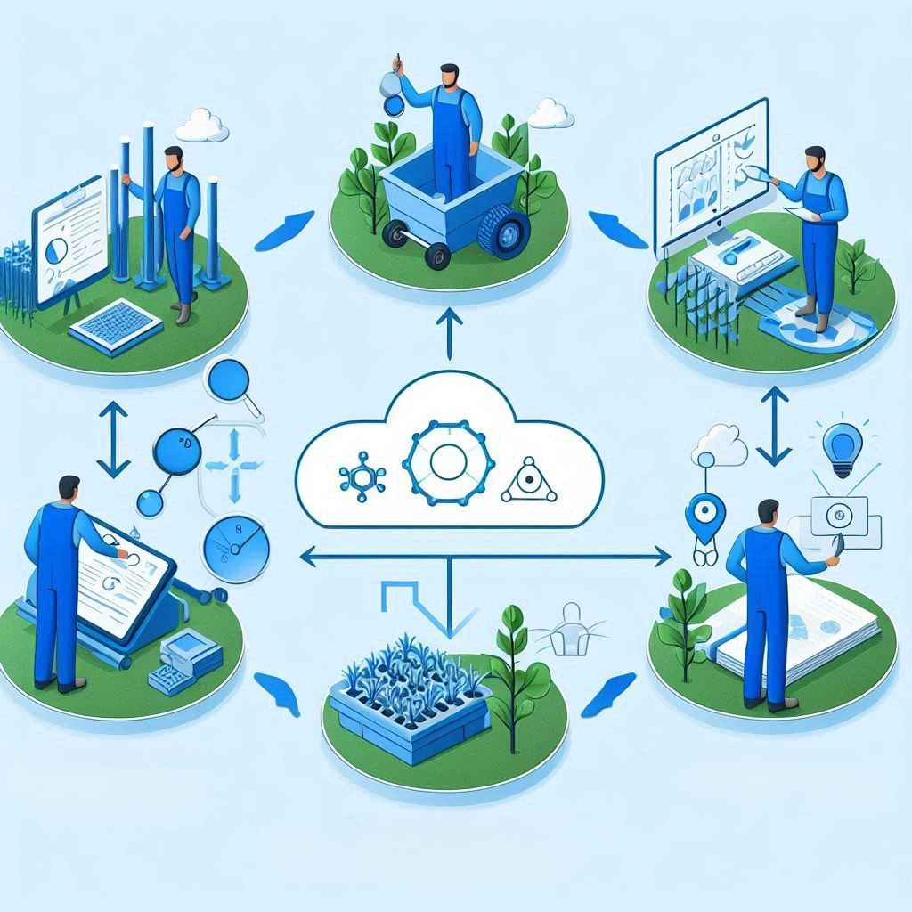
Data Collection & Analysis
Farmer Implementation
Recommendations
Illustrate the process flow from data collection to actionable insights delivered to farmers.

Slide 6
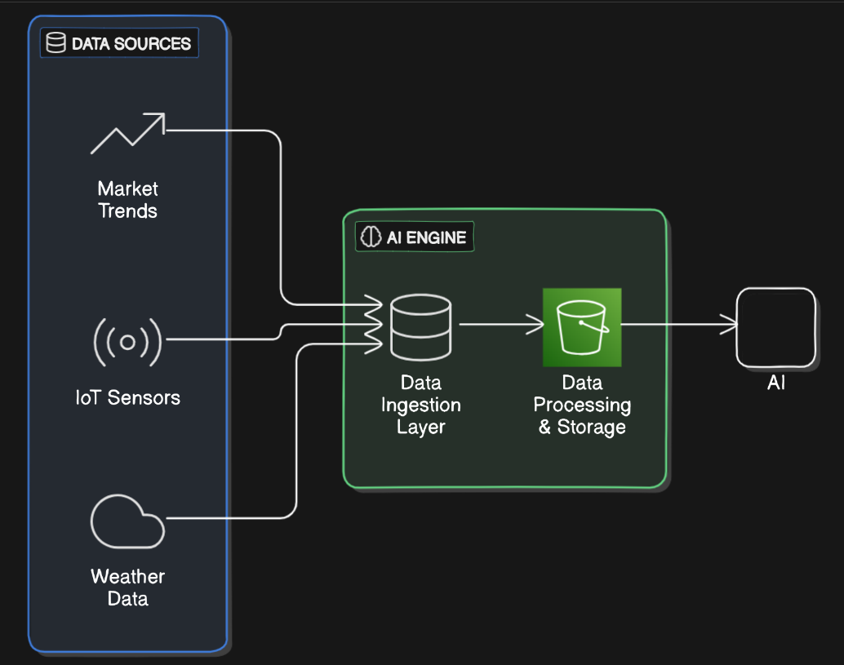
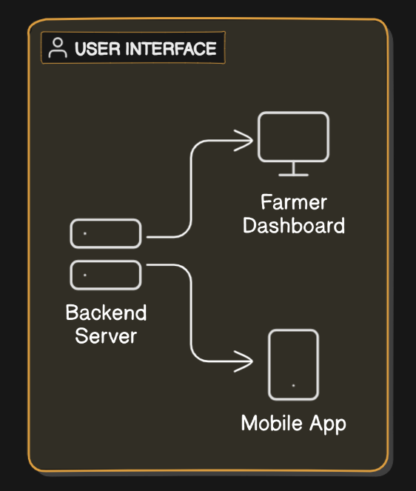
Architecture Diagrams

Slide 7
Technologies to be Used in the Solution
AI/ML Algorithms: For data analysis and prediction.
IoT Devices: For real-time data collection (soil sensors, weather stations).
Cloud Computing: For data storage and processing.
Mobile/Web Interface: For delivering insights to farmers.

Slide 8
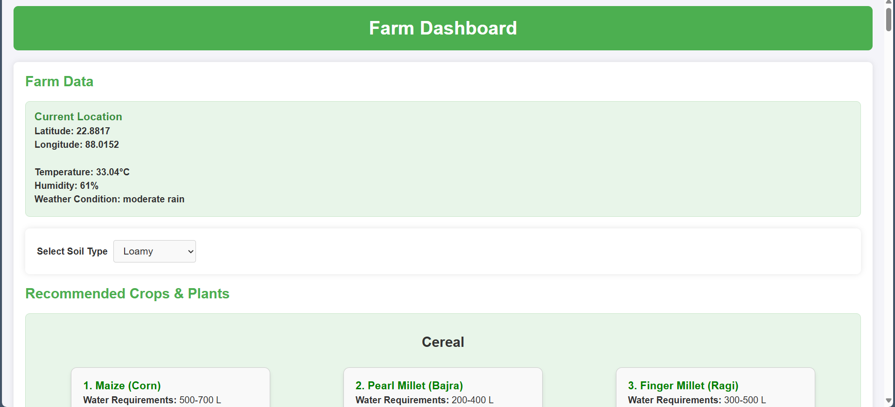
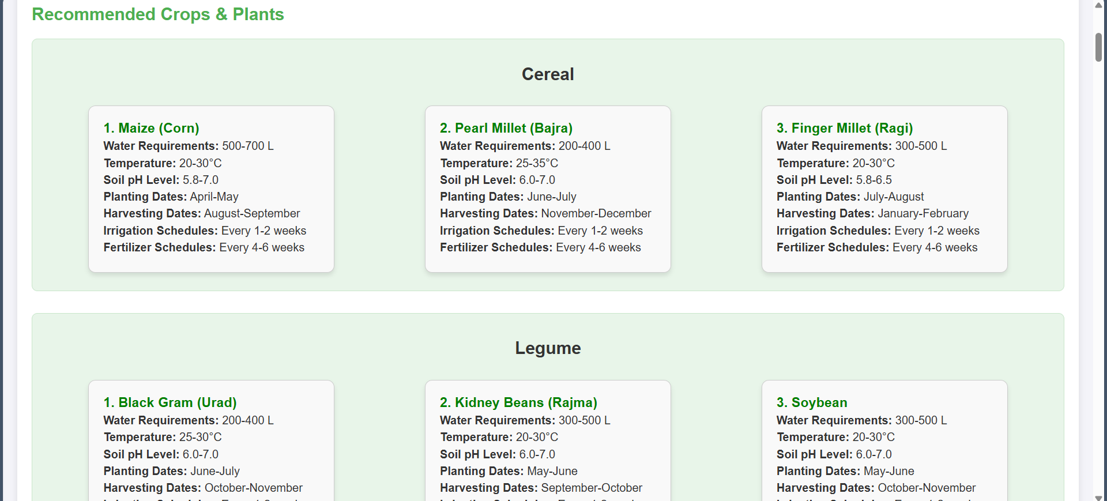
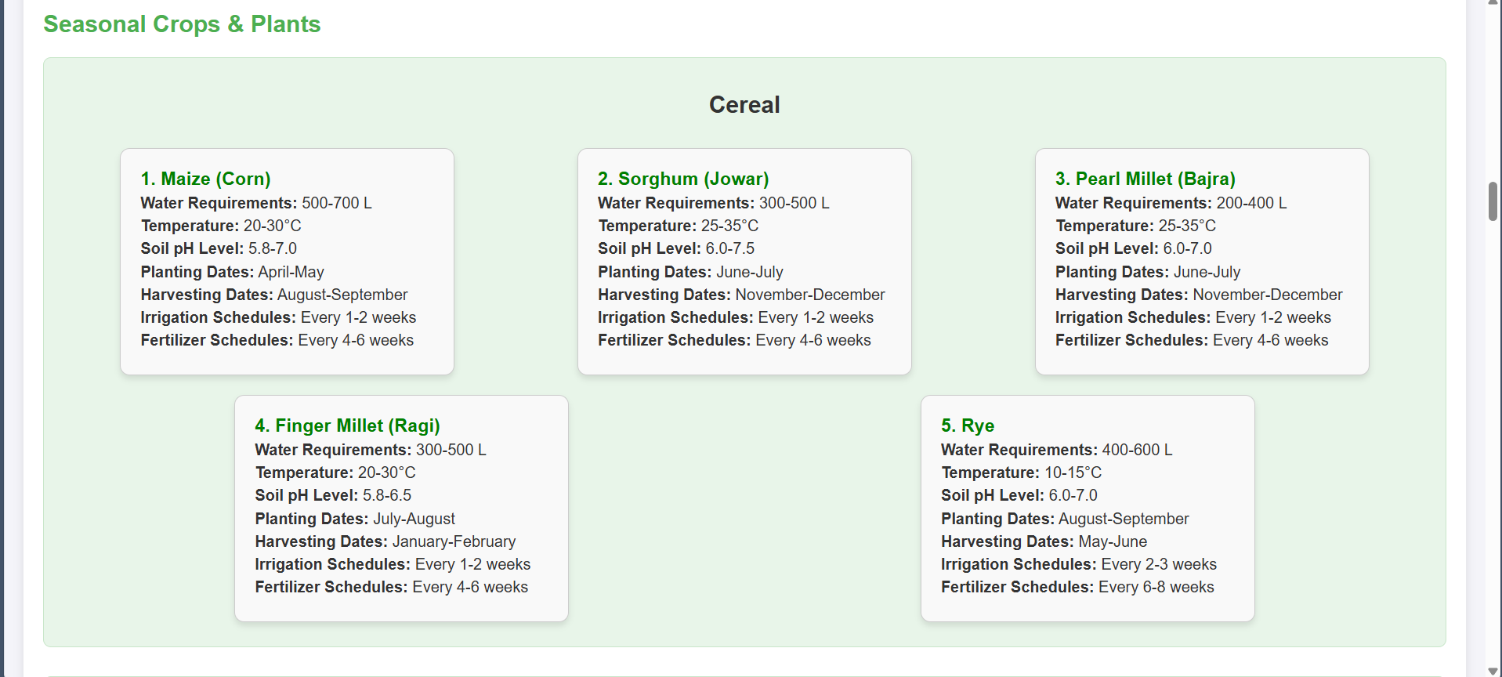
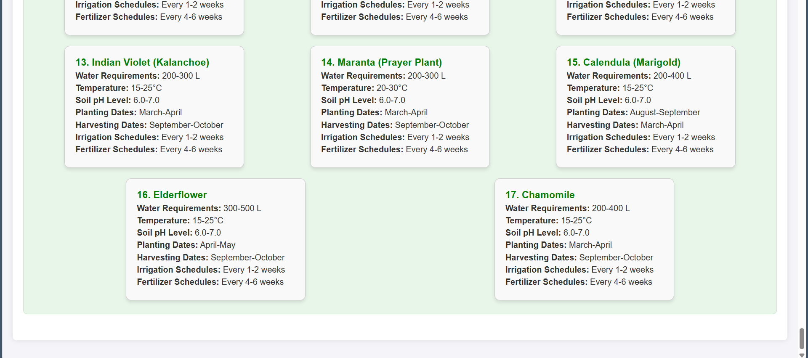
Snapshots of the prototype

Slide 9
Prototype Performance Report/Benchmarking
Recommendation Accuracy:
Crop selection: 85%
Planting times: 90%
Resource Efficiency:
Water usage may reduced by 25%
Fertilizer may optimization by 15%
Response Time:
Data processing: <1 seconds
Dashboard updates: <1 second
Scalability:
Designed to handle up to 1,000 concurrent users efficiently with the current setup.
Potential to scale up to 10,000 users with infrastructure upgrades and optimizations.
User Feedback:
Not provided to the users

Slide 10
Future Plans
Expand Data Sources:
Integrate additional data sources, including real-time soil conditions and more advanced sensors, to enhance the accuracy of recommendations.
Refine AI Algorithms:
Continuously improve AI models to increase the precision of crop and resource management recommendations.
Regional Scaling:
Scale the solution to cover more geographical regions, adapting to local climate and soil conditions.
Utilize Historical Data:
Leverage a larger dataset of historical climate and crop data to identify long-term patterns and trends.
Incorporate Real-time Market Trends:
Integrate real-time market data to provide farmers with up-to-date pricing and demand forecasts, optimizing their decisions for better profitability.

Slide 11
Important links:
GitHub Public Repository - https://github.com/md-shahid-ansari/ai-driven-farm.git
Demo Video Link - https://drive.google.com/file/d/15bsQ74i2ff6F1iM82nZ03FvfuK7uTFBh/view?usp=drive_link
Final Product Link - https://md-shahid-ansari.github.io/ai-driven-farm/

Slide 12
